Slide 1
Maven Key Concepts

Slide 2
Maven Key Concepts
POM File - pom.xml
Project Coordinates
www.luv2code.com

Slide 3

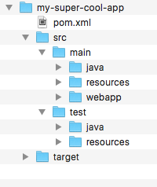

POM File - pom.xml
•
Project Object Model file: POM file
•
Configuration file for your project
Basically your “shopping list” for Maven :-)
•
Located in the root of your Maven project
www.luv2code.com

Slide 4






POM File Structure
Project name, version etc Output file type: JAR, WAR, …
pom.xml
List of projects we depend on Spring, Hibernate, etc…
Additional custom tasks to run: generate JUnit test reports etc…
www.luv2code.com

Slide 5




Simple POM File
<project ...>
<modelVersion>4.0.0</modelVersion>
<groupId>com.luv2code</groupId>
<artifactId>mycoolapp</artifactId>
<version>1.0.FINAL</version>
<packaging>jar</packaging>
<name>mycoolapp</name>
<dependencies>
<dependency>
<groupId>junit</groupId>
<artifactId>junit</artifactId>
<version>3.8.1</version>
<scope>test</scope>
</dependency>
</dependencies>
<!-- add plugins for customization -->
</project>
Project name, version etc Output file type: JAR, WAR, …
List of projects we depend on Spring, Hibernate, etc…
Additional custom tasks to run: generate JUnit test reports etc…
www.luv2code.com

Slide 6



Project Coordinates
Project Coordinates uniquely identify a project
Similar to GPS coordinates for your house: latitude / longitude
Precise information for finding your house (city, street, house #)
City
<groupId>com.luv2code</groupId>
<artifactId>mycoolapp</artifactId>
<version>1.0.FINAL</version>
Street
House Number
www.luv2code.com

Slide 7

Project Coordinates - Elements
Name | Description
Group ID | Name of company, group, or organization. Convention is to use reverse domain name: com.luv2code
Artifact ID | Name for this project: mycoolapp
Version | A specific release version like: 1.0, 1.6, 2.0 … If project is under active development then: 1.0-SNAPSHOT
<groupId>com.luv2code</groupId>
<artifactId>mycoolapp</artifactId>
<version>1.0.FINAL</version>
www.luv2code.com

Slide 8


Example of Project Coordinates
<groupId>com.luv2code</groupId>
<artifactId>mycoolapp</artifactId>
<version>1.0.RELEASE</version>
<groupId>org.springframework</groupId>
<artifactId>spring-context</artifactId>
<version>5.0.0.RELEASE</version>
<groupId>org.hibernate</groupId>
<artifactId>hibernate-core</artifactId>
<version>5.2.11.Final</version>
www.luv2code.com

Slide 9

Adding Dependencies
<project ...>
...
<dependencies>
<dependency>
<groupId>org.springframework</groupId>
<artifactId>spring-context</artifactId>
<version>5.0.0.RELEASE</version>
</dependency>
<dependency>
<groupId>org.hibernate</groupId>
<artifactId>hibernate-core</artifactId>
<version>5.2.11.Final</version>
</dependency>
...
</dependencies>
</project>
www.luv2code.com

Slide 10

Dependency Coordinates
To add given dependency project, we need
Group ID, Artifact ID
Version is optional …
Best practice is to include the version (repeatable builds)
DevOps
•
May see this referred to as: GAV
Group ID, Artifact ID and Version
www.luv2code.com

Slide 11
How to Find Dependency Coordinates
•
Option 1: Visit the project page (spring.io, hibernate.org etc)
•
Option 2: Visit http://search.maven.org (easiest approach)
www.luv2code.com

Slide 12
Maven Archetypes

Slide 13

Maven Archetypes
•
Archetypes can be used to create new Maven projects
•
Contains template files for a given Maven project
•
Think of it as a collection of “starter files” for a project
Java Project, Web Project, etc
archetype := starter project
www.luv2code.com

Slide 14
Common Archetypes
Archetype Artifact ID | Description
maven-archetype-quickstart | An archetype to generate a sample Maven project.
maven-archetype-webapp | An archetype to generate a sample Maven Webapp project.
… others … | …
http://maven.apache.org/archetypes
www.luv2code.com

Slide 15
Archetypes
•
You can create new projects using Maven Archetypes (starter project)
From the command-line with Maven
•
From an IDE
•
Eclipse, IntelliJ, NetBeans etc…
www.luv2code.com

Slide 16
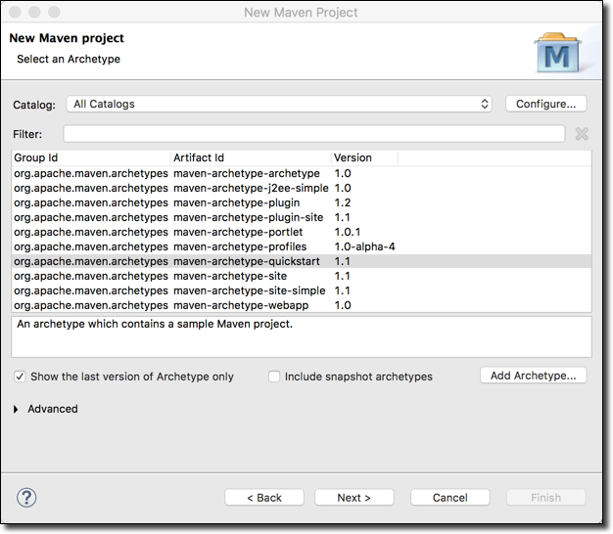
List of Archetypes - Eclipse
File > New Maven Project
www.luv2code.com

Slide 17
Quickstart Archetype
•
maven-archetype-quickstart contains a sample Maven project
project
pom.xml
src/main/java/App.java src/test/java/AppTest.java
www.luv2code.com

Slide 18
Webapp Archetype
•
maven-archetype-webapp contains a sample Maven webapp project
project
pom.xml src/main/webapp/index.jsp
src/main/webapp/WEB-INF/web.xml
www.luv2code.com

